Slide 1

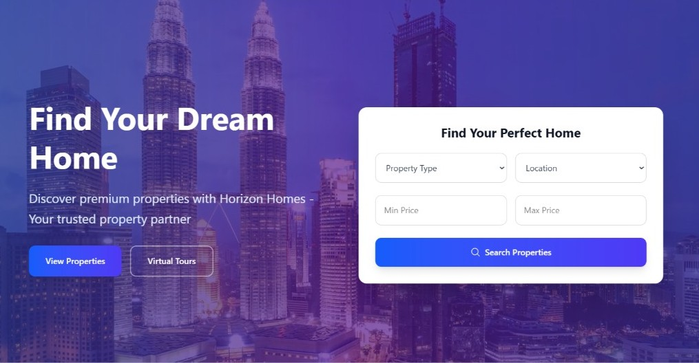

Project Title HorizonHomes: Smart Property Discovery & Management Platform
Presented by:
Md. Nazmus Sazzad Naiem ID: 2254901041
Jablay Noor Rahman (Omi) ID: 2254901093
Department of ICT Bangladesh University of Professionals (BUP)

Slide 2

Overview
Project Objective
Features of Website
Tools & Technology
Limitations
Future scope

Slide 3


Project Objective
Horizon Homes is a comprehensive website designed to streamline the process of searching, listing, and reserving residential properties. The platform offers secure user authentication, role-based access for visitors, agents, and admins, and property data management. It integrates features like booking, mortgage calculators, and neighborhood insights, creating a user-friendly, secure, and efficient experience for both property seekers and owners.

Slide 4

Features of HorizonHomes Real-Estate Website

Slide 5






Tools & Technology Used
HTML
Backend Connectivity
CSS
NodeJs
JavaScript
Express Js
React
Database
Mongodb

Slide 6


Limitations
🔹 1. Limited AI Features
The platform doesn’t yet use AI for smart property recommendations.
🔹 2. No Notification System
Users don’t receive real-time alerts for bookings or approvals.
🔹 3. Single Language Support
Currently, the platform supports only English—no multilingual options.
🔹 4. Limited Third-Party Integration
There’s no integration with services like Stripe, PayPal, or external real estate APIs.
🔹 5. Manual Admin Approvals
Property listings need manual admin approval, which could slow things down as the platform grows.

Slide 7




Future Works
User Review and Ratings
Payment Gateway Integration
Mobile Application Developemnt
Social Media Integration
Implement a user review and rating system where users can provide feedback and ratings for properties they have booked or visited.
Adding the Payment
help user in Securely doing the trasation of the property
Consider expanding the project by developing a dedicated mobile application for iOS and Android platforms.
Integrate social media sharing capabilities, allowing users to easily share properties or their booking experiences on social platforms.

Slide 8
THANK YOU

